Slide 1
The Basics of Disaster Preparedness: Incase “It Will Never Happen to Us” Happens Tomorrow Easy Emergency Planning tools
Laura Hortz Stanton, Executive Director, Conservation Center for Art & Historic Artifacts

Slide 2
It CAN happen to you!
NATURAL DISASTERS
Fire/wildfires
MANMADE DISASTERS
Vandalism/arson
Smoke/ash
Earthquake
Flood/rain storms
Tornado/high winds
Tsunami
Water leaks/sewage
Electrical/construction accidents
Bombs/terrorists
Chemical explosions
Volcano
Notes:
Types of man-made or natural disaster- it can happen to you.
Natural disaster depend on location (locale) and location of building
Manmade disasters- everyone is fairly susceptible.
Construction in or around building.
Landscaping/topography change – new flows of water
During construction- walk site every day
Chemicals- train track nearby, other potential sources
What are the biggest threats in Pittsburgh?
NATURAL [adjust this to highlight the threats for each region]
Fire can be both natural (lightening, wildfire, etc.) and human-caused (electrical, vandalism, etc)
Also mudslides from heavy rains. Flooding can result from heavy rains, but also dam or dike failures.
MANMADE/HUMAN
No matter how low our risk may be to natural disasters, we all run the very high risk from human-caused disasters!
Vandalism can result in fire, water, really any of these on the list.
Something like 80% plus of emergencies and disasters affecting libraries, happen when construction is going on in or around a library building. It is when you need to take extra care.
Most common culprit is water damage – natural water disasters, plumbing problems, leaky roofs, fire hoses, sprinkler discharge, condensation, sewage backup and mold
Water requires prompt and effective action which will be talking about more.
We should focus on the emergency-type situations where quick response will keep the emergency from becoming a disaster
All staff should understand their role to promptly and effectively respond to unusual smells, overloaded or overheated equipment, and unusual behavior by users. Another reason why staff training is so important.
Let’s take a look at a horror slide show

Slide 3
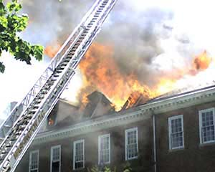
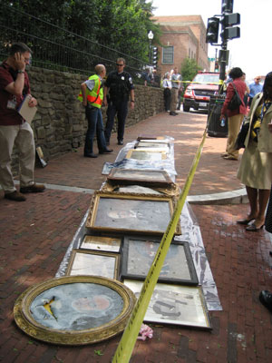
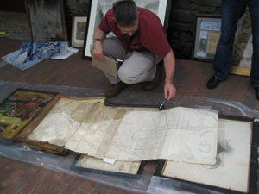
Notes:
FIRE: Monday, April 30, 2007 -- 72 year-old Georgetown Public Library.
The blaze was apparently caused when the worker was using the heat gun to remove paint and other material from a window on the second floor. The branch, like other city libraries, had no fire-suppression system.
To make matters worse, water pressure and fire hydrants in the area was not working well, the fire quickly spread and the roof collapsed down into the building onto the second floor. The Peabody Room which is the DC archive for original maps, documents, books, and artwork for Georgetown was located in this area.
A valiant effort was made by fire personnel to evacuate materials ahead of the fire and a quickly as possible after.
The library director, who was a recently on the job, climbed into a fire engine with a commander, and helped to direct responders to the priority areas in the building!

Slide 4
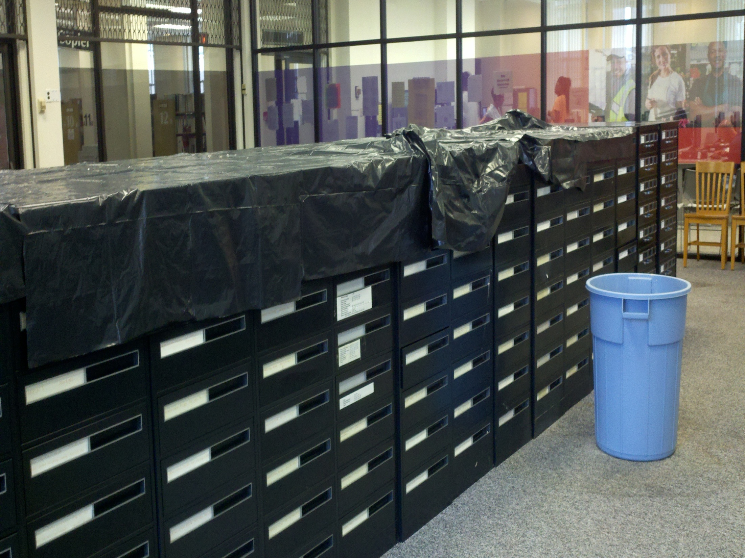
Notes:
Wilmington Institute Public Library
Leak during Hurricane Irene.
Quick protection with trash bags
Can be prepared if you know something is coming.
Know your weak areas that need to be protected

Slide 5
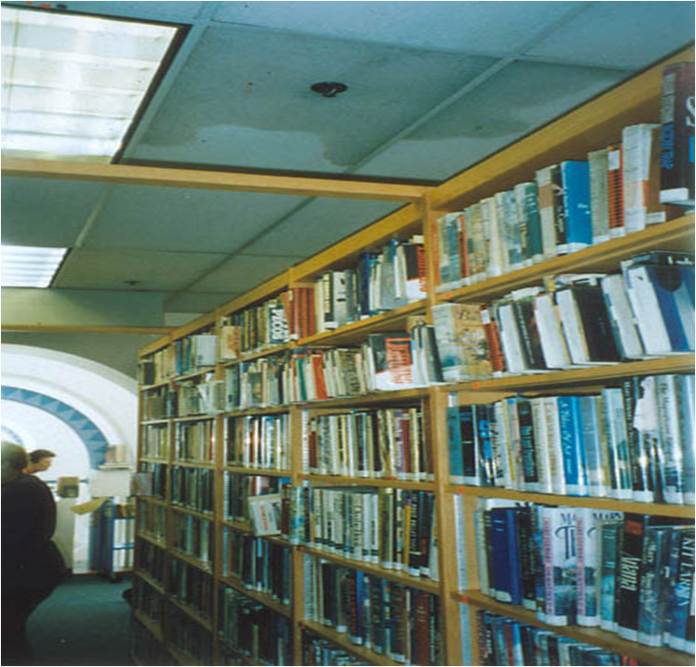
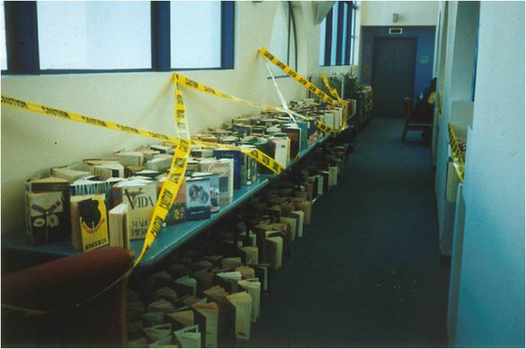
Notes:
A public library
Unlike accidents, vandalism is intentional and can cause many forms of damage. We’ve already seen the effects of arson, the most common cause of library fires.
WATER: Oceanside Public Library 3/17/98 Mischievous ARSON
Juveniles put a burning piece of paper under the fire sprinkler, triggering one sprinkler head that ran for about 10 minutes. Can see the water-logged ceiling panel
Interesting, because the library didn’t want this event publicized for fear of copycats!
Several thousand books were slightly wet from the driving force of the sprinkler.
NOT a gentle spray!
Major air-drying operation was possible. Library used the opportunity to weed the fiction collection which was most heavily impacted.
Air drying requires a large amount of space. Used every area possible. Windows opened and fans were running.

Slide 6
Key Steps in Disaster Preparedness
Before
Prevention
Preparation
During
After
Response
Recovery
Follow Through
Notes:
Our key steps in disaster preparedness are the same for all types of cultural heritage institutions.
Today’s are in green
Part 1: Prevention and Preparation (may touch on response)
Part 2: Response, along with Recovery and Follow Through that includes training.
The driving motivation behind the first three, is that the better prepared the institution and the efficiency with which it responds, the more likely the recovery will be successful and the costs kept down.
Let’s look more closely at these Key Steps.

Slide 7
Easy Tools for Planning

Slide 8
Emergency Response and Salvage Wheel
Side 1: Action Steps
Side 2: Salvage Steps by materials type
Available through the American Institute for Conservation
$10
http://store.conservation-us.org
Notes:
he Emergency Response and Salvage Wheel is a hands-on tool that explains how to save collections. Whether you're facing spring floods, summer hurricanes, or winter storms, this easy slide chart helps you: Protect precious collections and significant records
Find reliable information instantly
Save damaged objects you thought were lost forever!
The Emergency Response and Salvage Wheel has essential information to help you cope quickly and effectively when disaster strikes. Side one contains action Steps outlines critical stages of disaster response, such as stabilizing the environment and assessing damage. Side two includes salvage steps which provides practical tips for nine types of collections: books and documents, photographs, electronic records, paintings, and more.

Slide 9
Field Guide to Emergency Response
Step by step guide to emergency response
Easy to use checklist
DVD for training
Available through the American Institute for Conservation
$22
http://store.conservation-us.org
Notes:
Follow the Field Guide’s step-by-step instructions tailored to the scope of your emergency: what to do first, whom to call, how to prevent further damage. Form a response team to deal with multiple tasks, including working with emergency responders, assessing and documenting damage, ensuring health and safety of staff, and setting up a salvage operation. Stabilize your collections with advice from professionals on handing the most common types of damage from water, mold, corrosion, pests, and other threats. Customize handy checklists for your institution and find vital conservation resources.

Slide 10
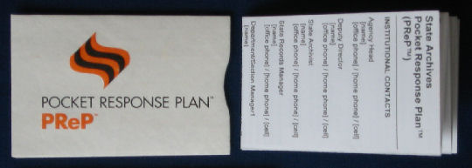
Pocket Response Plan (PReP)™
makes essential information easily
accessible
pocket size / fits in envelope
cost effective / easy to update
https://www.statearchivists.org/programs/emergency-preparedness/emergency-preparedness-resources/pocket-response-plantm-prep-tm-english-template/
Notes:
You all rcvd this as homework attachment
PULL OUT YOUR PReP: ((generic printouts in back of binder))
Easy to adapt / can incl. most critical info
e.g. drop in floor plans, utility shut offs
Great tool – ensures that staff have essential info. needed within first 24hours with them at all times
BUT it is meant to complement / not replace the disaster plan
Side A Communications
Side B Actions

Slide 11
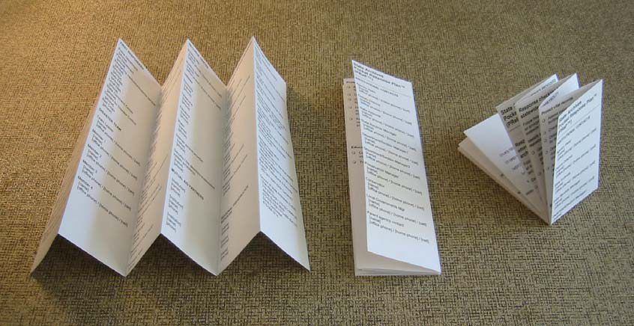
Notes:
Just accordion folds, then fold in half and fits into
Tyvek envelope – Council of State Archivists developed the PReP (Pocket Response Plan)
Envelopes $5 / 10 pack – COSA website & folding instructions along bottom
…. Also fits nicely behind badge

Slide 12
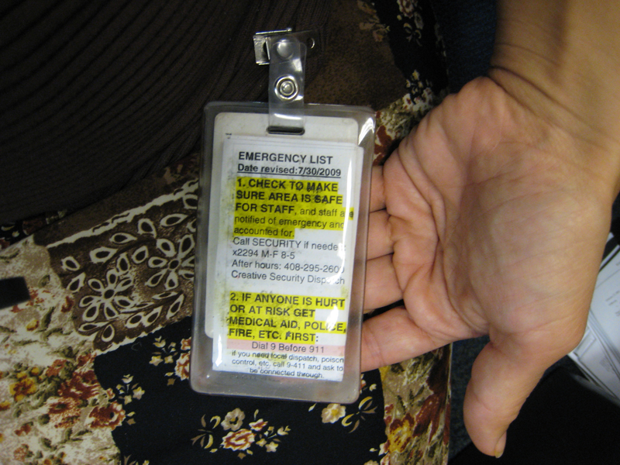

Slide 13
Pocket Response Plan (PReP)™
SIDE A: COMMUNICATIONS
Institutional Contacts
Building Utilities
First Responders
Emergency Recovery Services
Regional Contacts
Staff Phone Tree
Notes:
((THIS IS PLANNED AS THE LAST SLIDE BEFORE LUNCH))
Front side of the PReP Plan deals with Communications
Institutional contacts
Use this version as a guide for thinking about people and groups that should be contacted.
Delete entries that don’t apply / add those that do. Or Combine i.e. facilities person and security person might be same person
Notice that multiple modes of contact are included for reaching key people. More responsibility person has = more imperative
No extensions – spell out number
Where is your server? In flooded basement? ….might need home email google/yahoo accts will be up
Text msgs can be more reliable than phone calls
Need to plan for after hours emergencies / needs to work for least experienced person on staff
Disaster team
4 people minimum / 6-8 better / remember neighboring institutions

Slide 14
Pocket Response Plan (PReP)™
SIDE B: ACTIONS
Immediate Response
Assessment
Communication
Collection Salvage
Collection Priorities
Incident Command System
Notes:
Side B / column by column
We will be going back and forth between Handouts and Appendices that supplement your PReP
Back side of the PReP Plan deals with Actions ((they only work on side A for homework))
Remember, the PReP is easily modified. You can delete entries that don’t apply to your institution and add those that do. Use this version as a guide for thinking about the actions that are appropriate for you.

Slide 15
Preparedness makes good sense …
Helps to minimize damage
Expedites response & recovery
Saves time, trouble & expense
Replaces chaos with thoughtful response & recovery
Allows for prompt resumption of service

Slide 16
Laura Hortz Stanton
Executive Director
Conservation Center for Art &Historic Artifacts
lhortzstanton@ccaha.org
(215) 545-0613
Notes:
Don’t let this be you!

